Slide 1
Turning Old Smartphones into IP Cameras with Python
Hannah Turk
April 18, 2016

Slide 2
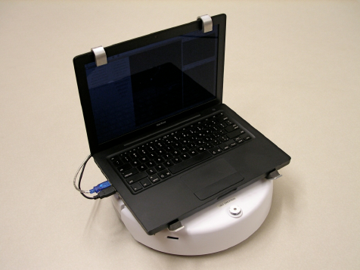
Robotics Research with Prof. Dodds
Image processing & computer vision
Expand the system’s functionality to a variety of accessible hardware
Notes:
Every summer, Prof. Dodds advises a group of students to do robotics projects having to do with navigation based on image processing and computer vision. Typically, the setup consists of a laptop on top of a robot, where the webcam feed is directly input to the laptop for image processing. But this summer he wants to try a new setup - do we need a laptop on the robot?

Slide 3
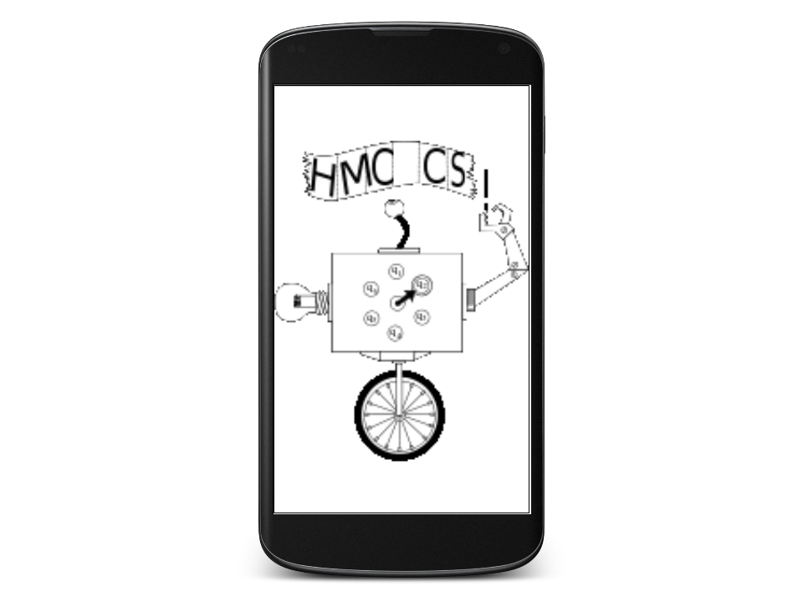
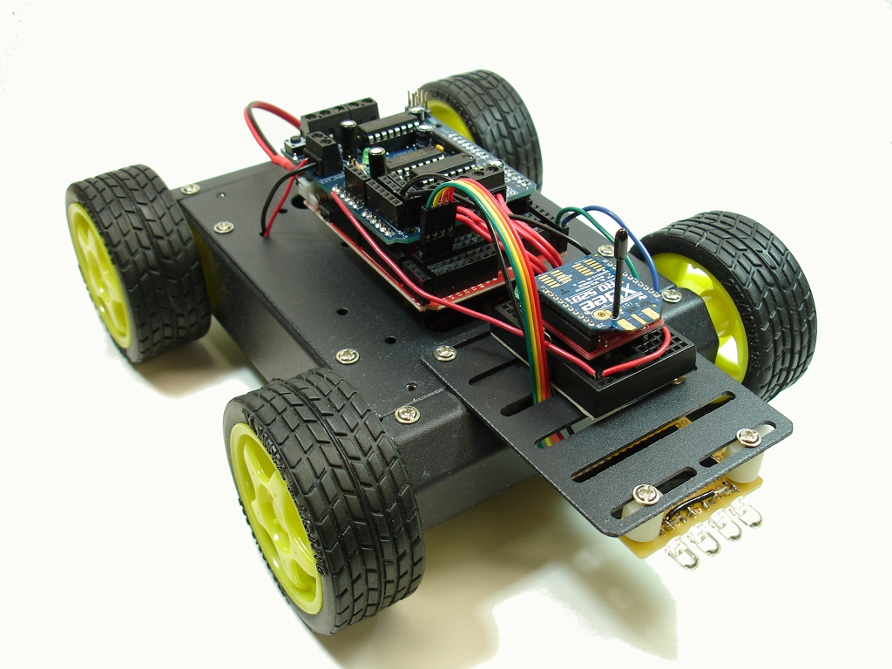
Summer 2016 Research
Image processing & computer vision tasks with
old smartphones
We want the smartphone to act like a webcam
Notes:
There’s no need to do the image processing with a machine ATTACHED to the robot. We have the internet!
What if we attached an old smartphone to the robot instead? If we could find a way to relay the video feed back wirelessly to the processing code, that’s great! It gives us a lot more flexibility: a smartphone is a LOT less bulky than a laptop.

Slide 4
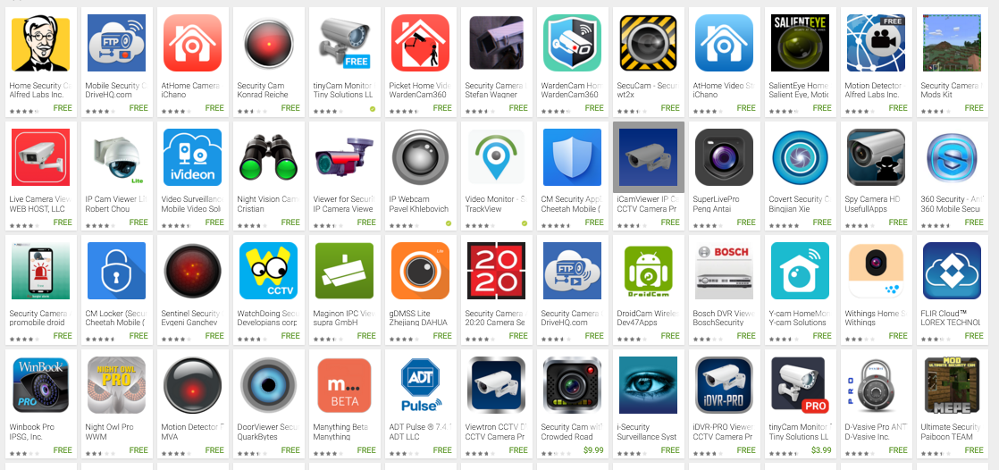
In CS, never design what you can steal!
Notes:
So how do you send the video feed from the phone to a remote system?
I didn’t need to make my own app, because I found one that did a lot of the work for me!
Searched for “security camera” on app store

Slide 5
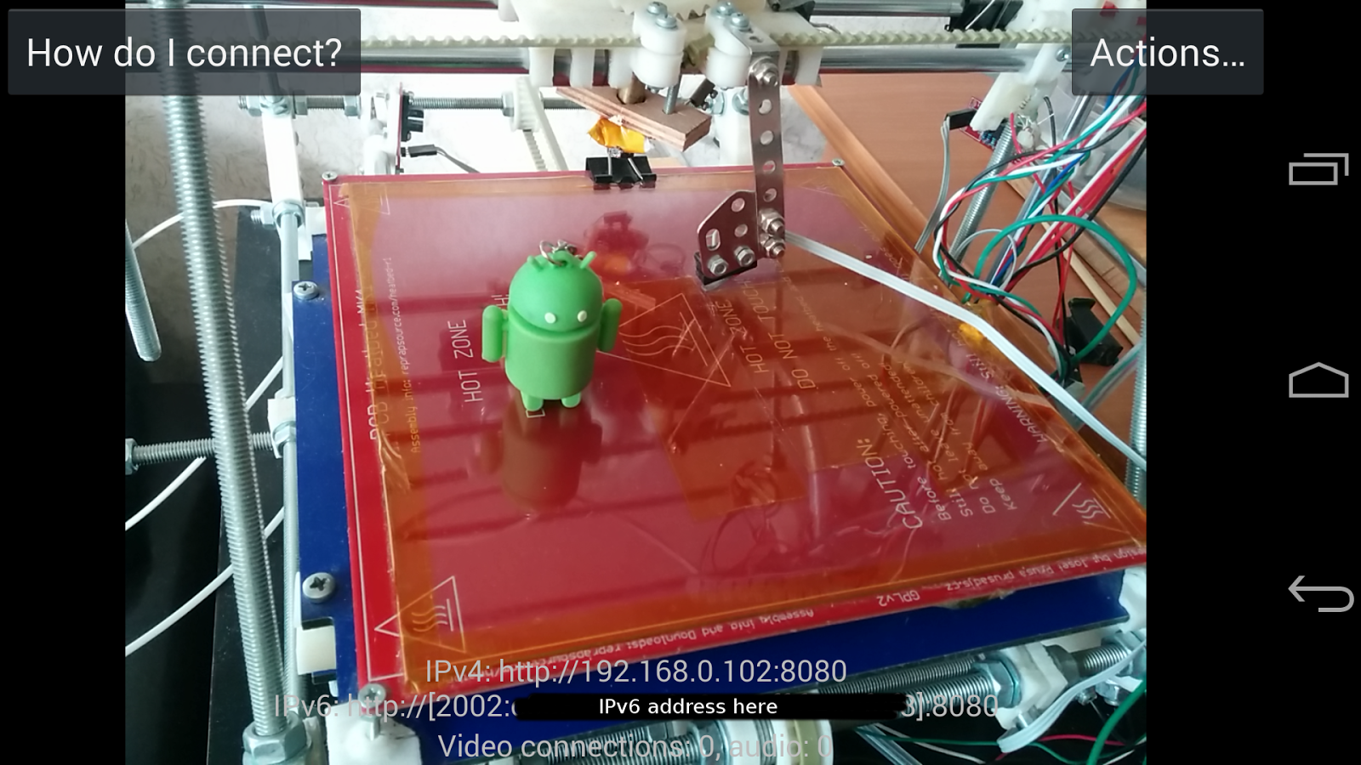
IP Webcam App: send video feed to given IP address & Port 8080

Slide 6
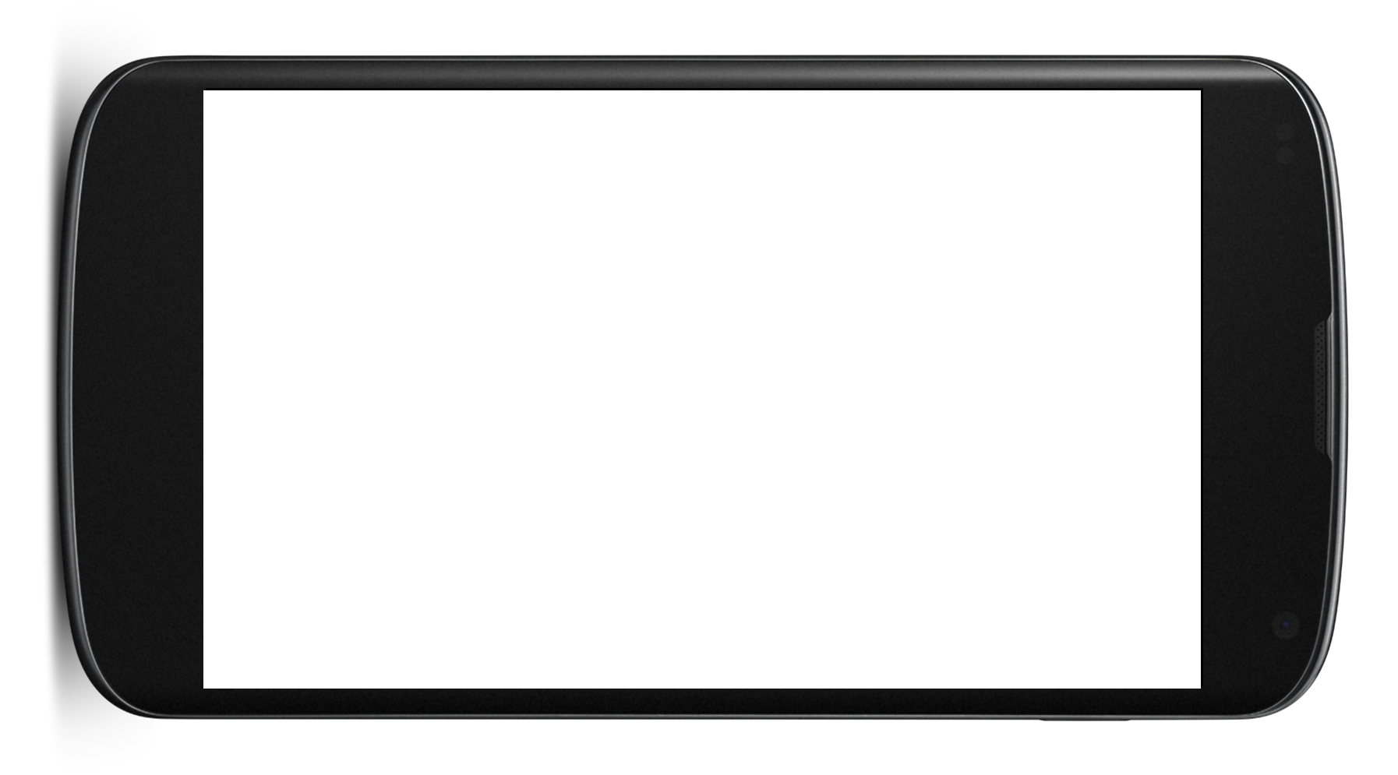
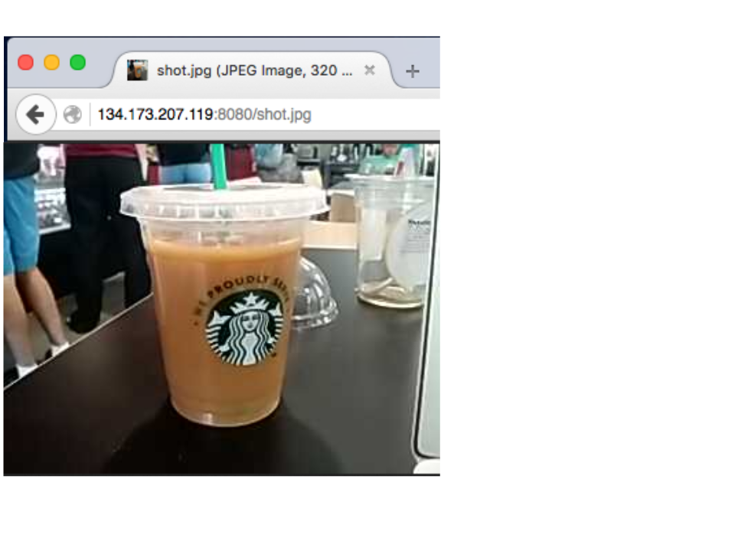

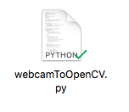
System Overview
IP Webcam
Notes:
Video feed taken from IP Webcam app gets posted to URL, which is input to the Python program. The Python program processes the images and calls the OpenCV color detection functions. Then we see the output in an OpenCV window.

Slide 7
Demo

Slide 8
Questions?

Slide 9
Image Sources
Laptop on Roomba: https://www.researchgate.net/profile/Omair_Khan/publication/228774537/figure/fig1/AS:300888431317001@1448748800428/Figure-1-Apple-MacBook-laptop-mounted-on-top-of-an-iRobot-Create-The-MacBook-provides.png
RC vehicle: http://nootropicdesign.com/projectlab/wp-content/uploads/2012/02/roboticsPlatform.jpg
Android phone: http://io13-high-dpi.appspot.com/images/n4_large.png
HMC CS logo: https://www.cs.hmc.edu/style/cslogo_vector_2in.gif
Python logo: http://mall.rusrek.com/files/item_2658897.png
OpenCV logo: https://upload.wikimedia.org/wikipedia/commons/thumb/3/32/OpenCV_Logo_with_text_svg_version.svg/2000px-OpenCV_Logo_with_text_svg_version.svg.png

